Slide 1


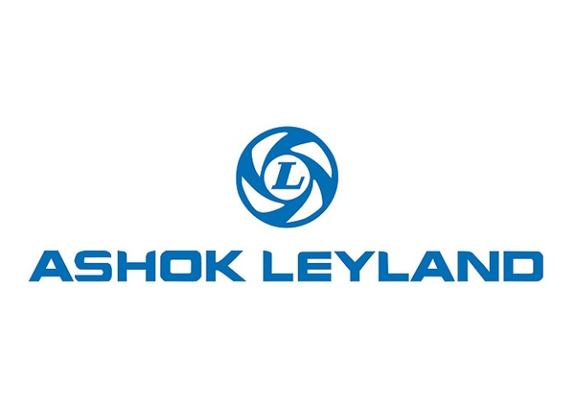


Industrial Strategy – Grand Challenge
Future of Mobility

Slide 2
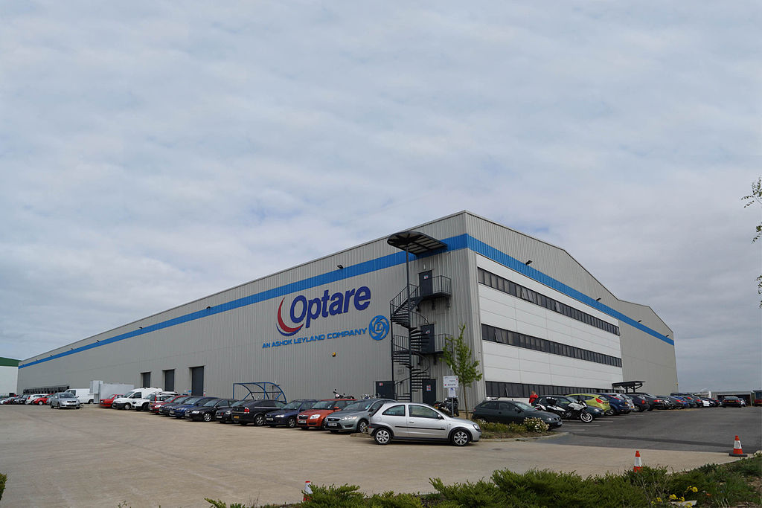
Optare
  Rural location (Sherburn in Elmet)
  MBO in 1985 from Leyland’s C H Roe in Leeds
  10,000 buses sold (UK, Europe, S Africa, US, ME, ANZ and HK)
  Main customers are Groups (i.e. First, GoAhead, Stagecoach, Arriva, TransDev)
  Ashok Leyland took control in 2011 (98% owned now)
    £3bn turnover truck & bus manufacturer
    World’s 4th largest bus builder
    Part of London-based Hinduja Group
  £90m investment across the business to date
  New factory in 2011; co location from 3 sites
  Leeds, Manchester and Rotherham:
    500 + units capacity
  360 employees total

Slide 3
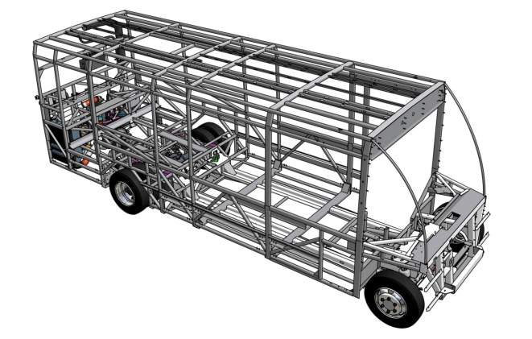
Optare USPs
Style
  Maximum kerb & interior appeal – ease of customisation
Efficiency
  Lightweight via unique & robust monocoque space frame
  Lowest Total Cost of Ownership
Environment
  Leadership in EVs
  Class leading mpg on diesel
Partnership
  Ease of Maintenance & Operation
  Industry leading aftercare

Slide 4
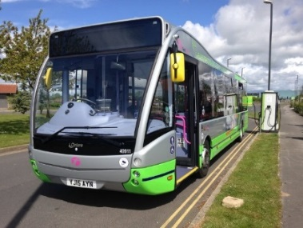
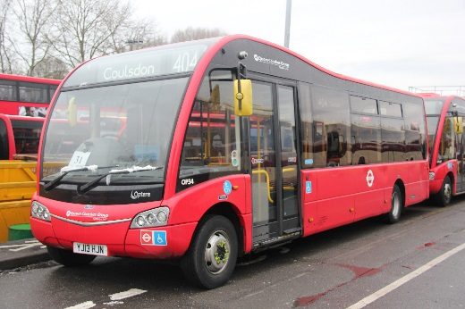
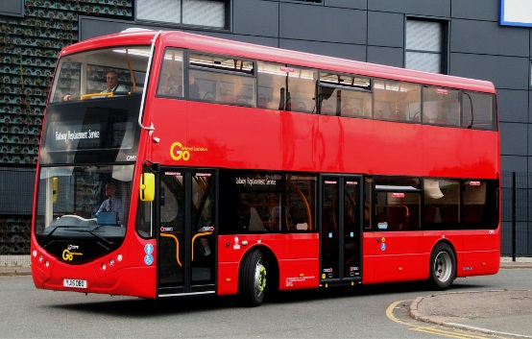
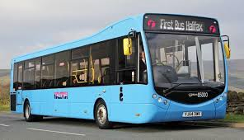
Product Range – Euro 3, 4, 5 and 6 and EV
A full bus range. Lightest in class. Leading efficiency
Small Single Deck | Large Single Deck | Double Deck
Solo | Metrocity & Versa | Metrodecker
23 – 33 Seats | 36 – 45 Seats | 63 - 84 Seats
60 total capacity <7T ULW Diesel <8T ULW EV | 60 total capacity <8T ULW Diesel <9T ULW EV | 99 capacity <11T ULW
8m – 10m length | 10m – 11.7m length | 10.5m – 11.1m length

Slide 5
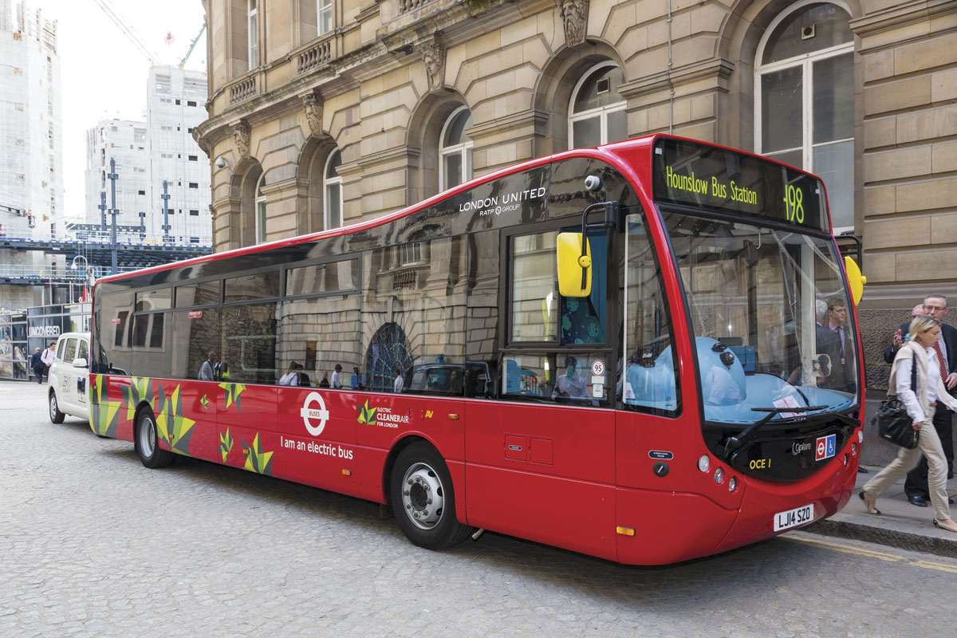
Metrocity
240kW Battery Capacity
150 mile range plus with HVAC (matches best in class even compared to buses with 380kW capacity)
No loss in passenger capacity (up to 60 PAX and 44 seats)
Unique 5 hour slow charge via on board chargers – plugs into 3 Phase supply
2.5 hours fast charge via off board chargers
12T GVW (lightest in class)
7 Year Battery Warranty
Won first all electric route in Wales (Rural)

Slide 6
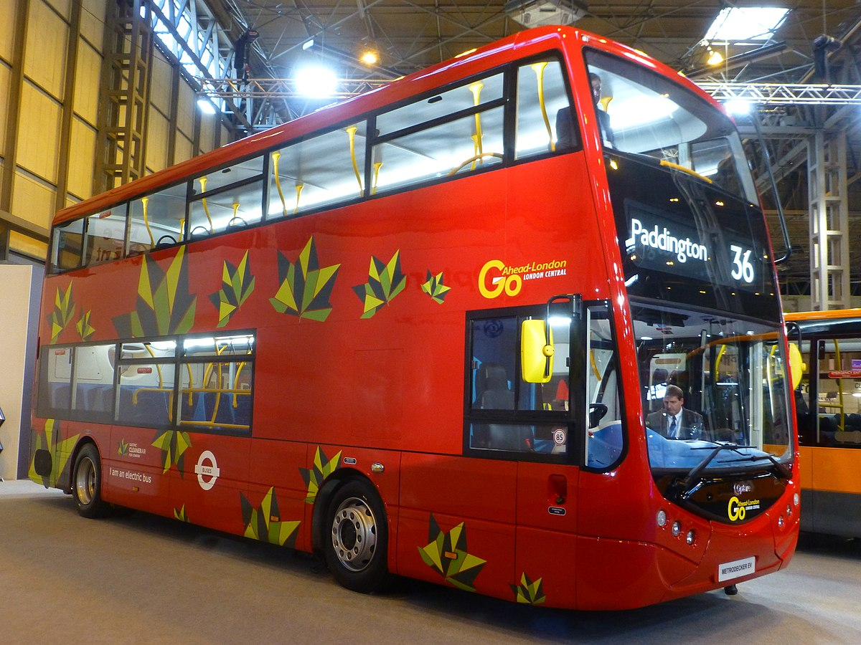
Metrodecker
300kW Battery Capacity
Lowest energy consumption per km of all competitors
Same basic bus as diesel, looks the same
150 miles range plus with HVAC (30% more than competitors)
Uniquely charges in 6 hours via on board chargers – plugs into 3 Phase supply
Fast charge in 3 hours via off board chargers
92 passenger capacity. 63 seated
18T GVW (lightest in class)
Won first all-electric double deck route in London and York

Slide 7
What Does the Future Mobility Look Like for Rural Communities
Current Reality (Studies by Greener Journeys):
  No bus services (not profitable and not seen as a Government priority)
  No charging infrastructure for electric vehicles
  No local shopping centres (we buy on line)
  Ageing population, increased isolation and associated mental illness

Slide 8
What Does the Future Mobility Look Like for Rural Communities
What could it look like:
  Use of solar farms to provide local/green electricity to charging points at rural business.
  Individuals using solar roof panels with charging points to charge their cars.
  Charging points/stations are the enablers for people to buy electric cars.
  Use small ‘community’ funded low floor (accessible) electric buses to provide meaningful public services (not minibuses).
  Opportunity then to embrace automation; ready for it.
Grand Challenges:
  Need for a Future of Mobility - Rural Strategy to complement the Urban Strategy
  Align transport, energy and agricultural innovation (solar power for automated farming = power for electric mobility).
  Fund rural trials of automation (aligned to automated farming).
  Proportionally allocate infrastructure and Ultra Low Emission Buses (ULEB) funding between Urban and Rural initiatives

Slide 9
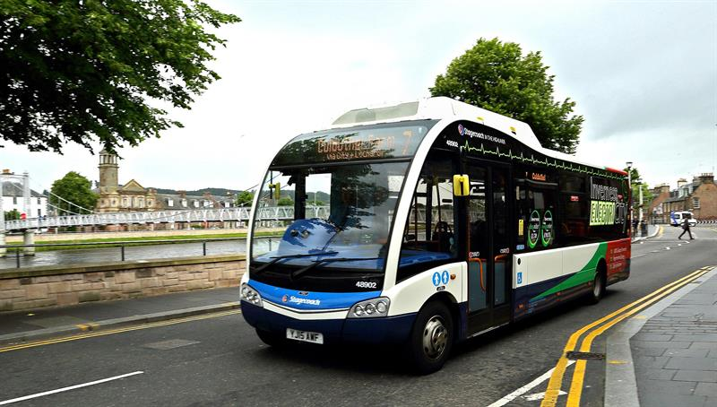
First All Electric Bus Operating in Inverness

